Slide 1
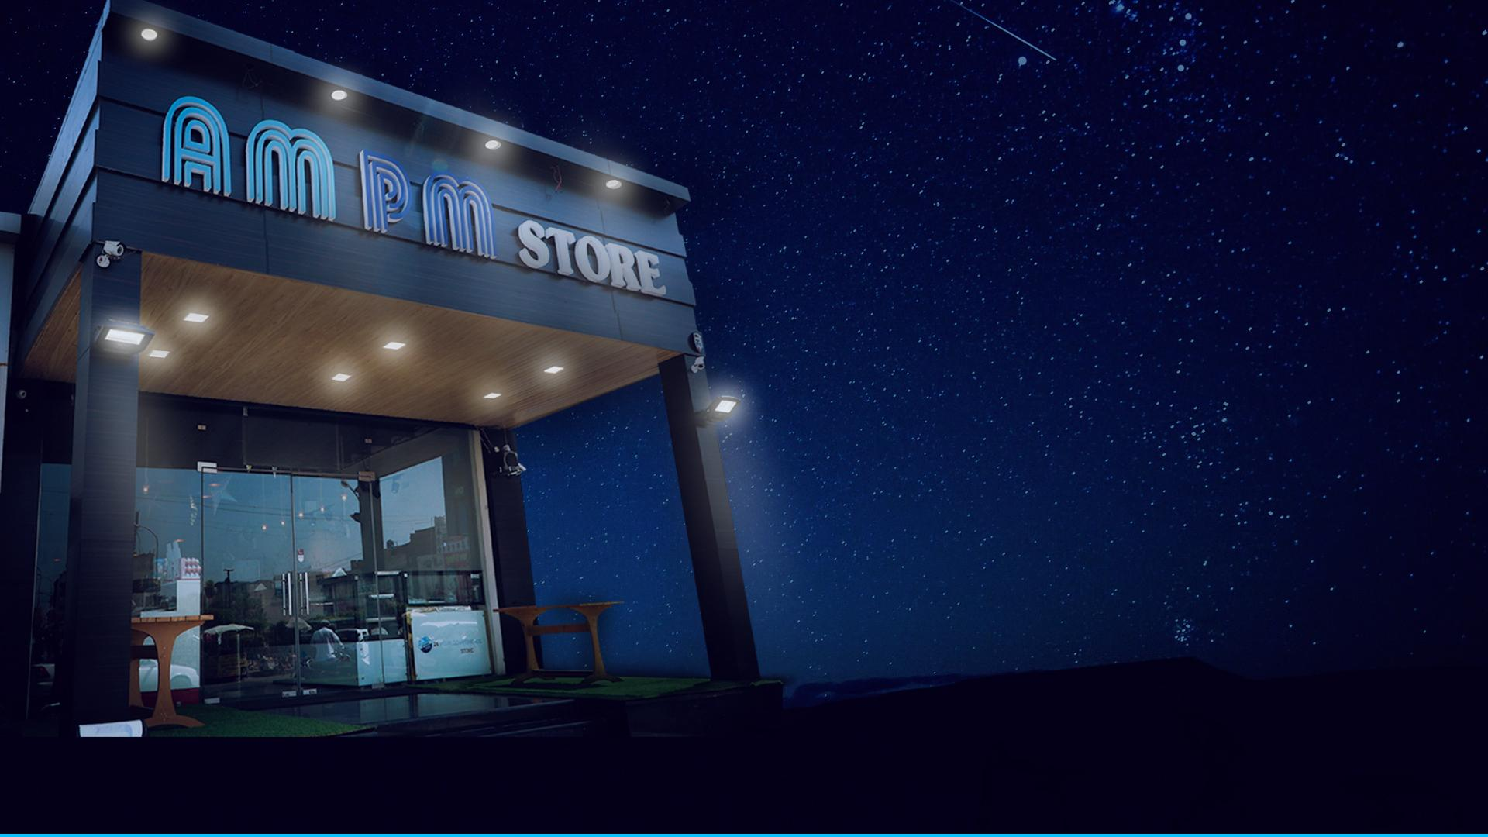
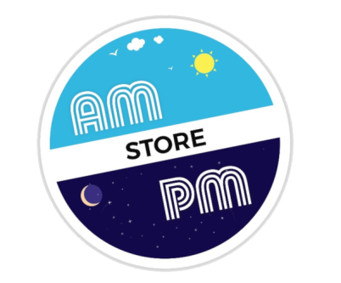
24*7 Convenience Store
Day & Night Customer Delight

Slide 2





Growth Catalysts
Round the Clock Work
BPOs, Rural Call Centers, Day & Night Manufacturing, Travelers, Late night Parties, Get together , 24 hour assistance
Aspirational Youth Thinking Global Acting Local
Web, Net savvy youth exposed to real time global developments operates in a 24h milieu demands 24h facility round the clock, wide range of imported and branded products.
Growing Disposable Income
Growing Income in Cities & towns
Current Facilities Traditional Nukkad Shops
Current offerings unhygienic, unhealthy, lacking variety, no quality control
Changing Lifestyles
Migration, Single Workers, Small families, Eating Out

Slide 3


Problem & Solution
?
!
PROBLEM
SOLUTION
Limited day time access only
Non-availability of branded and imported goods
Unorganized Kiryana stores
Non-standardized & spurious products
No quality control
Unhygienic fresh food products
Limited range of products
Poor Ambience of locality
Non-availability at night
Non-availability of delivery options
No safeguard for customers
Odd hour service experience
Standardized branded and imported goods
Organized convenience store
All in one store
Quality check
Health & hygienic food
Wide range of products
International shopping experience
24*7 Availability
Delivery format
Safe environment

Slide 4
Why Us?
Core Value
Day & Night Customer Delight by providing
International Quality
day to day convenience items at best unbeatable quality
Vision
Mission
Expansion Plans
Serve the people’s needs round the clock
Be Leader in the affordable 24/7 Convenience stores
1000 stores Pan India by 2025

Slide 5

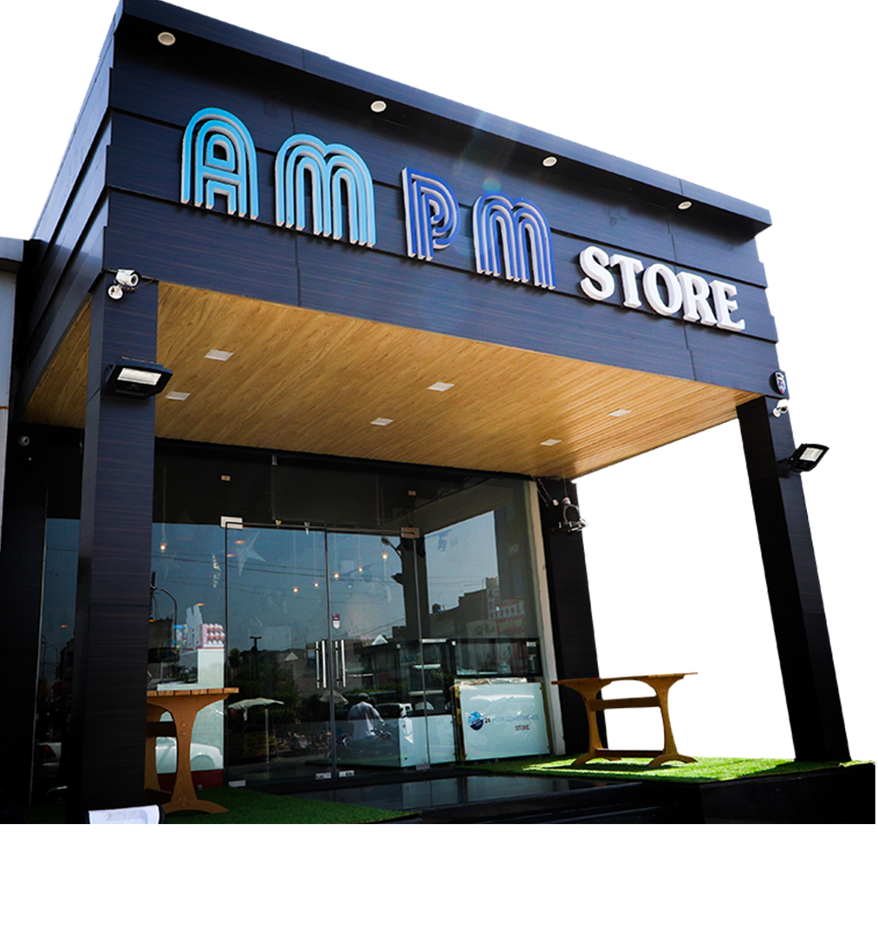
Business Model
Flagship showroom in each state hub
Franchisee development across each hub
Kiryana stores conversion
Supply chain market linkages in each hub

Slide 6
Revenue Model
MODEL | INVESTMENT | CARPET AREA | INVENTORY | Expected Sales | GROSS MARGIN | EXPENSES | OPERATION BREAK-EVEN | CAPITAL BREAK-EVEN | ROYALTY
SATELLITE CITY TIER-1 | 90+10 | 2000 sq. ft. | 20 LAKHS | 60 LAKHS | 40% | 6 LAKHS | 3 MONTHS | 24 MONTHS | 3 % OF REVENUE OR 6% of REVENUE
TIER-2,3,4 | 60+10 | 1500 sq. ft. | 10 LAKHS | 30 LAKHS | 33% | 3 LAKHS | 3 MONTHS | 24 MONTHS | 3 % OF REVENUE OR 6% of REVENUE

Slide 7
Competitor Analysis
PLAYER | GROCERY PRODUCTS | BAKERY PRODUCTS | LIVE KITCHEN | HOME DELIVERY | IMPORTED PRODUCTS | VEG. & NON-VEG. | EXCLUSIVE SHOWROOM
AMPM STORE | YES | YES | YES | YES | YES | YES | YES
24 SEVEN | LIMITED | LIMITED | LIMITED | NO | YES | YES | YES
EASY DAY | YES | NO | NO | NO | NO | NO | NO
IN & OUT | LIMITED | NO | NO | NO | NO | NO | NO
RELIANCE FRESH | YES | NO | NO | NO | NO | NO | NO
VISHAL MART | YES | NO | NO | NO | NO | NO | NO
LOCAL MARKET | YES | NO | NO | NO | NO | NO | NO
CARRE FOUR | YES | NO | NO | NO | NO | NO | NO

Slide 8
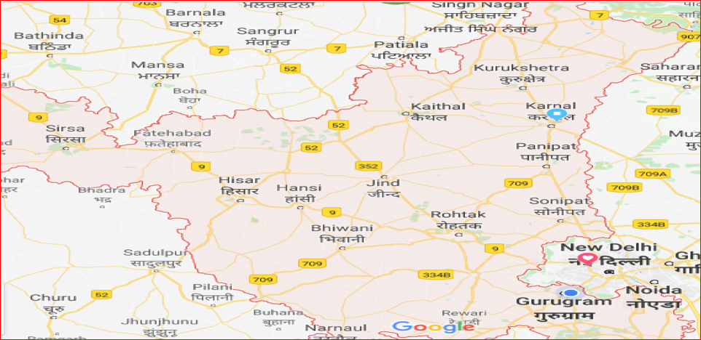

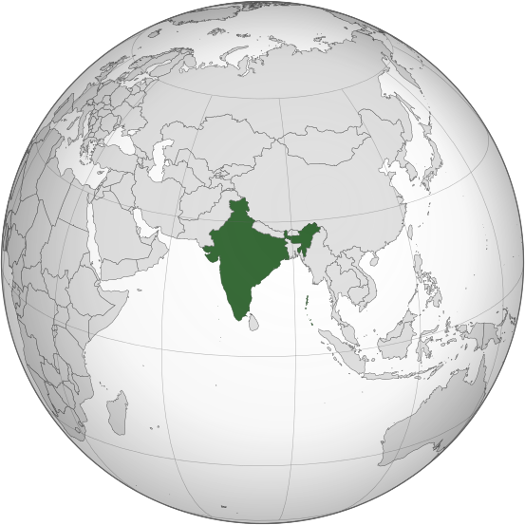
Short-Term Plan (Saturate Haryana)
HARYANA

Slide 9

3 Year Plan
Saturate Haryana
Saturate Delhi-NCR
Sales 30 Crore per month
100 stores across cities
Supply chain at each hub

Slide 10
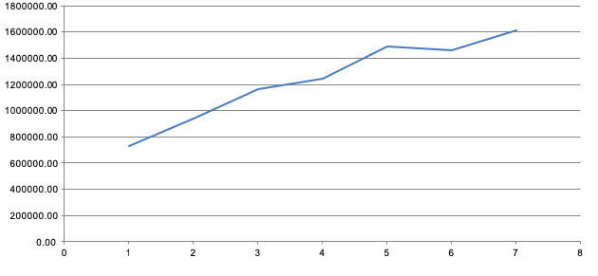
Financial Overview
Sales
Months

Slide 11








Store Format
One stop shop for all daily essentials with 24*7 delivery
Groceries
Bakery
Snacks
Beverages
Imported Products
Gift Baskets
100% Pure Veg
Daily Needs

Slide 12
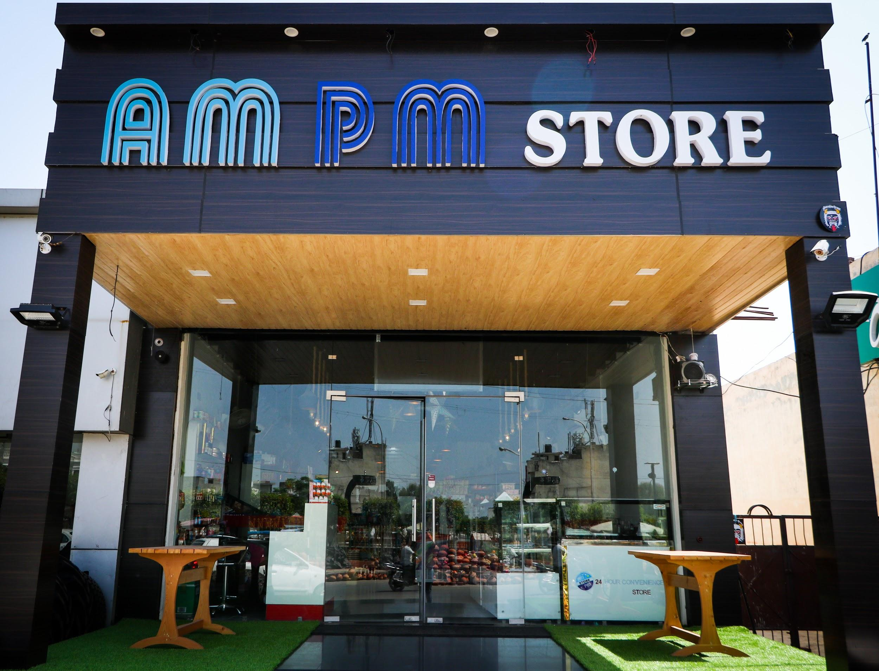
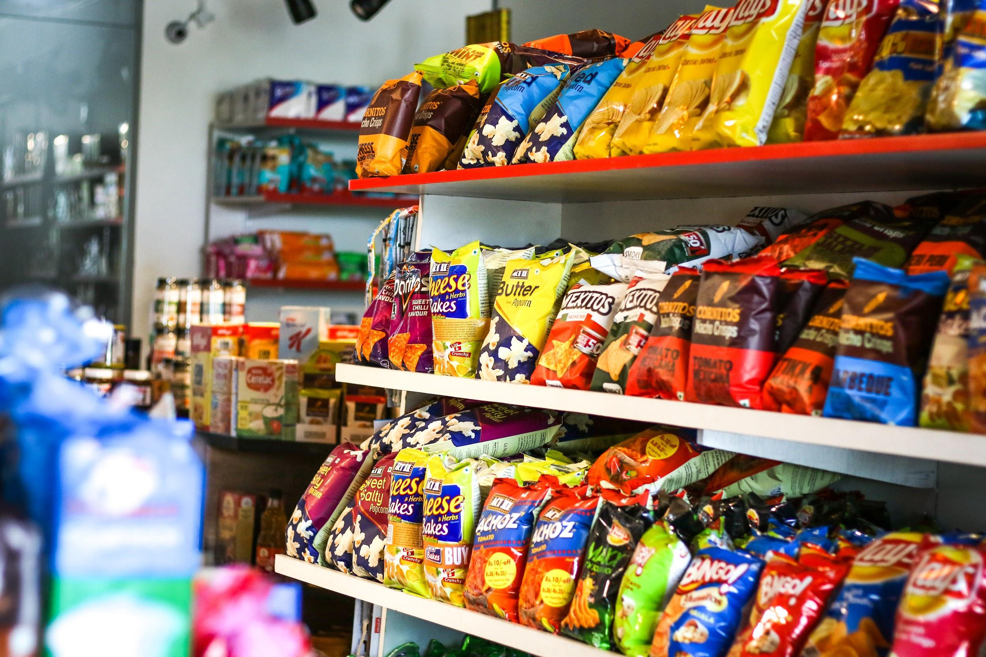
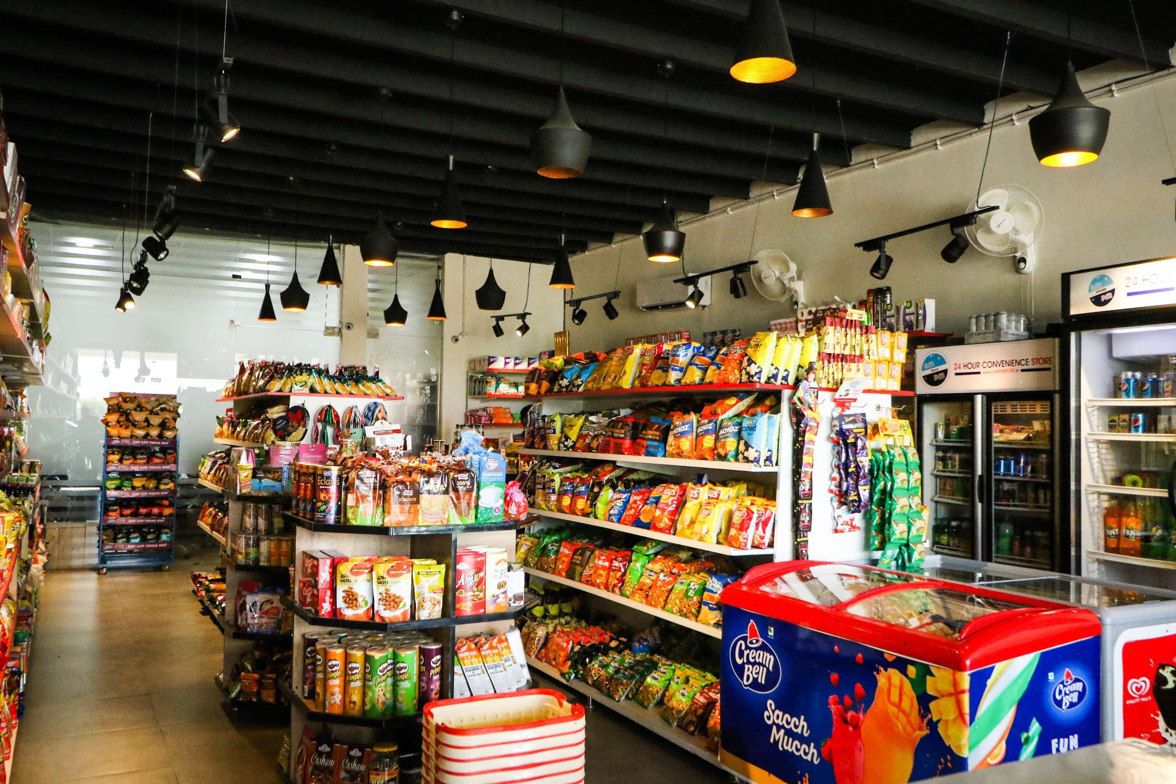
The AMPM Store

Slide 13
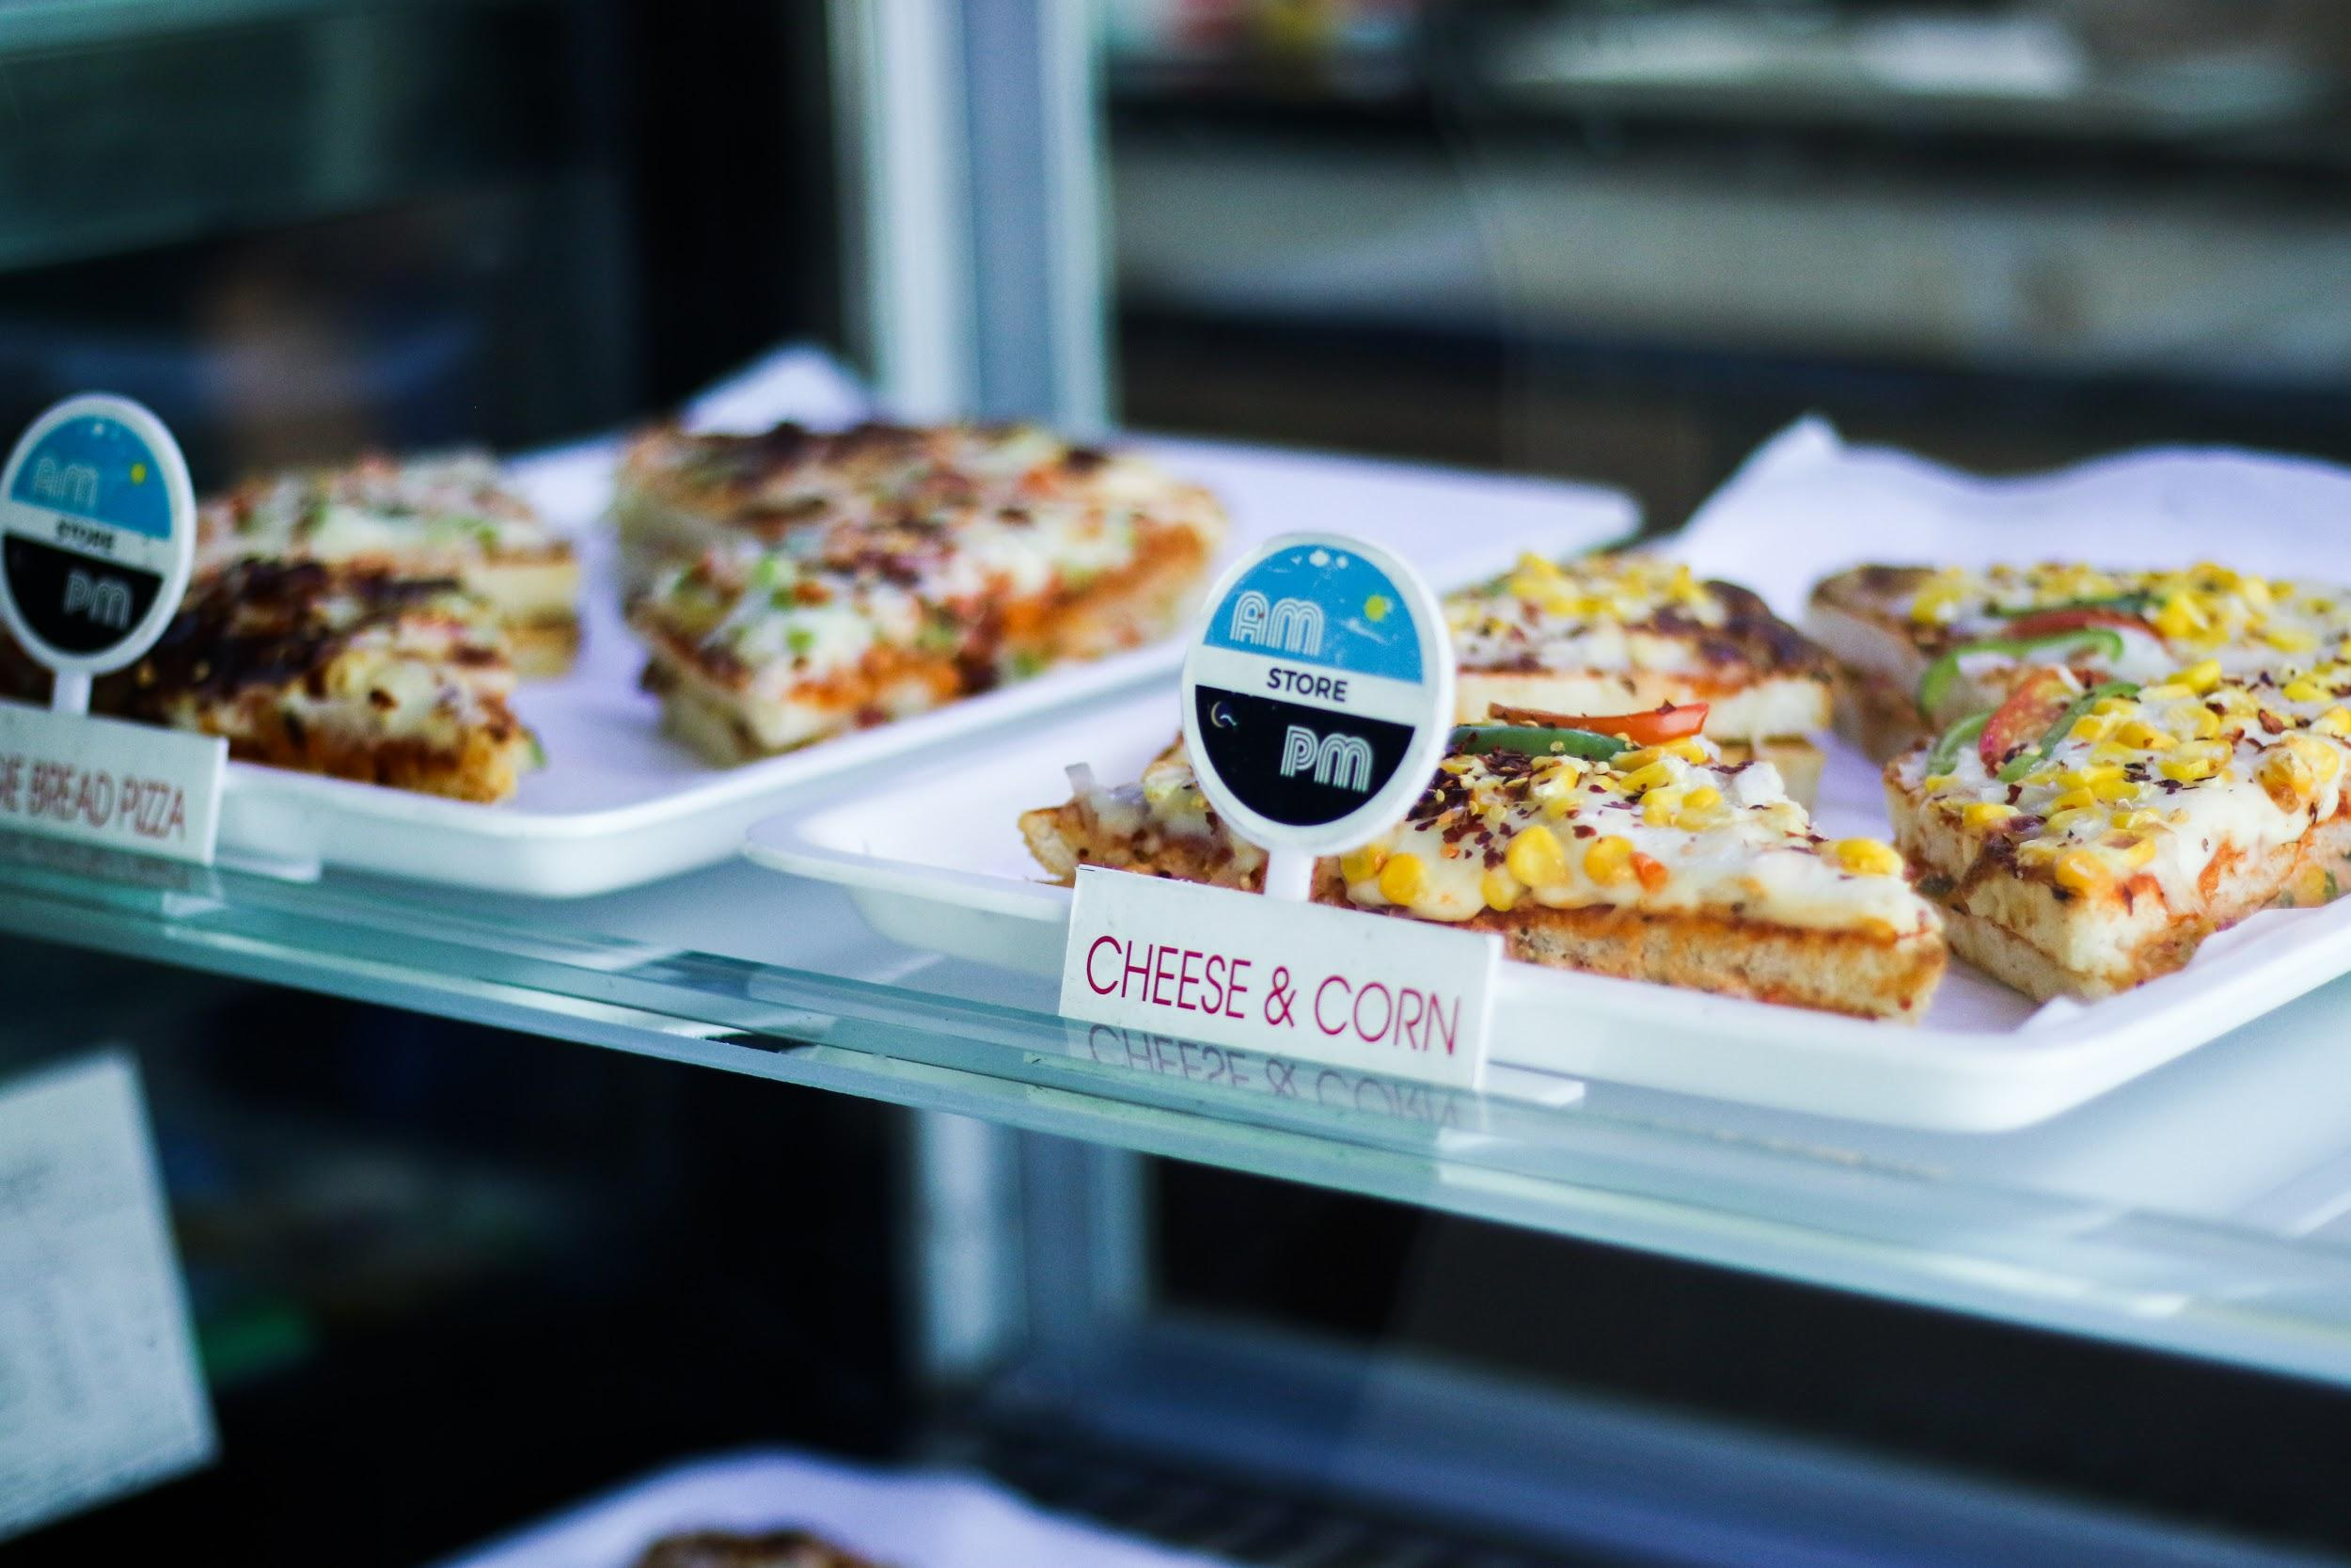
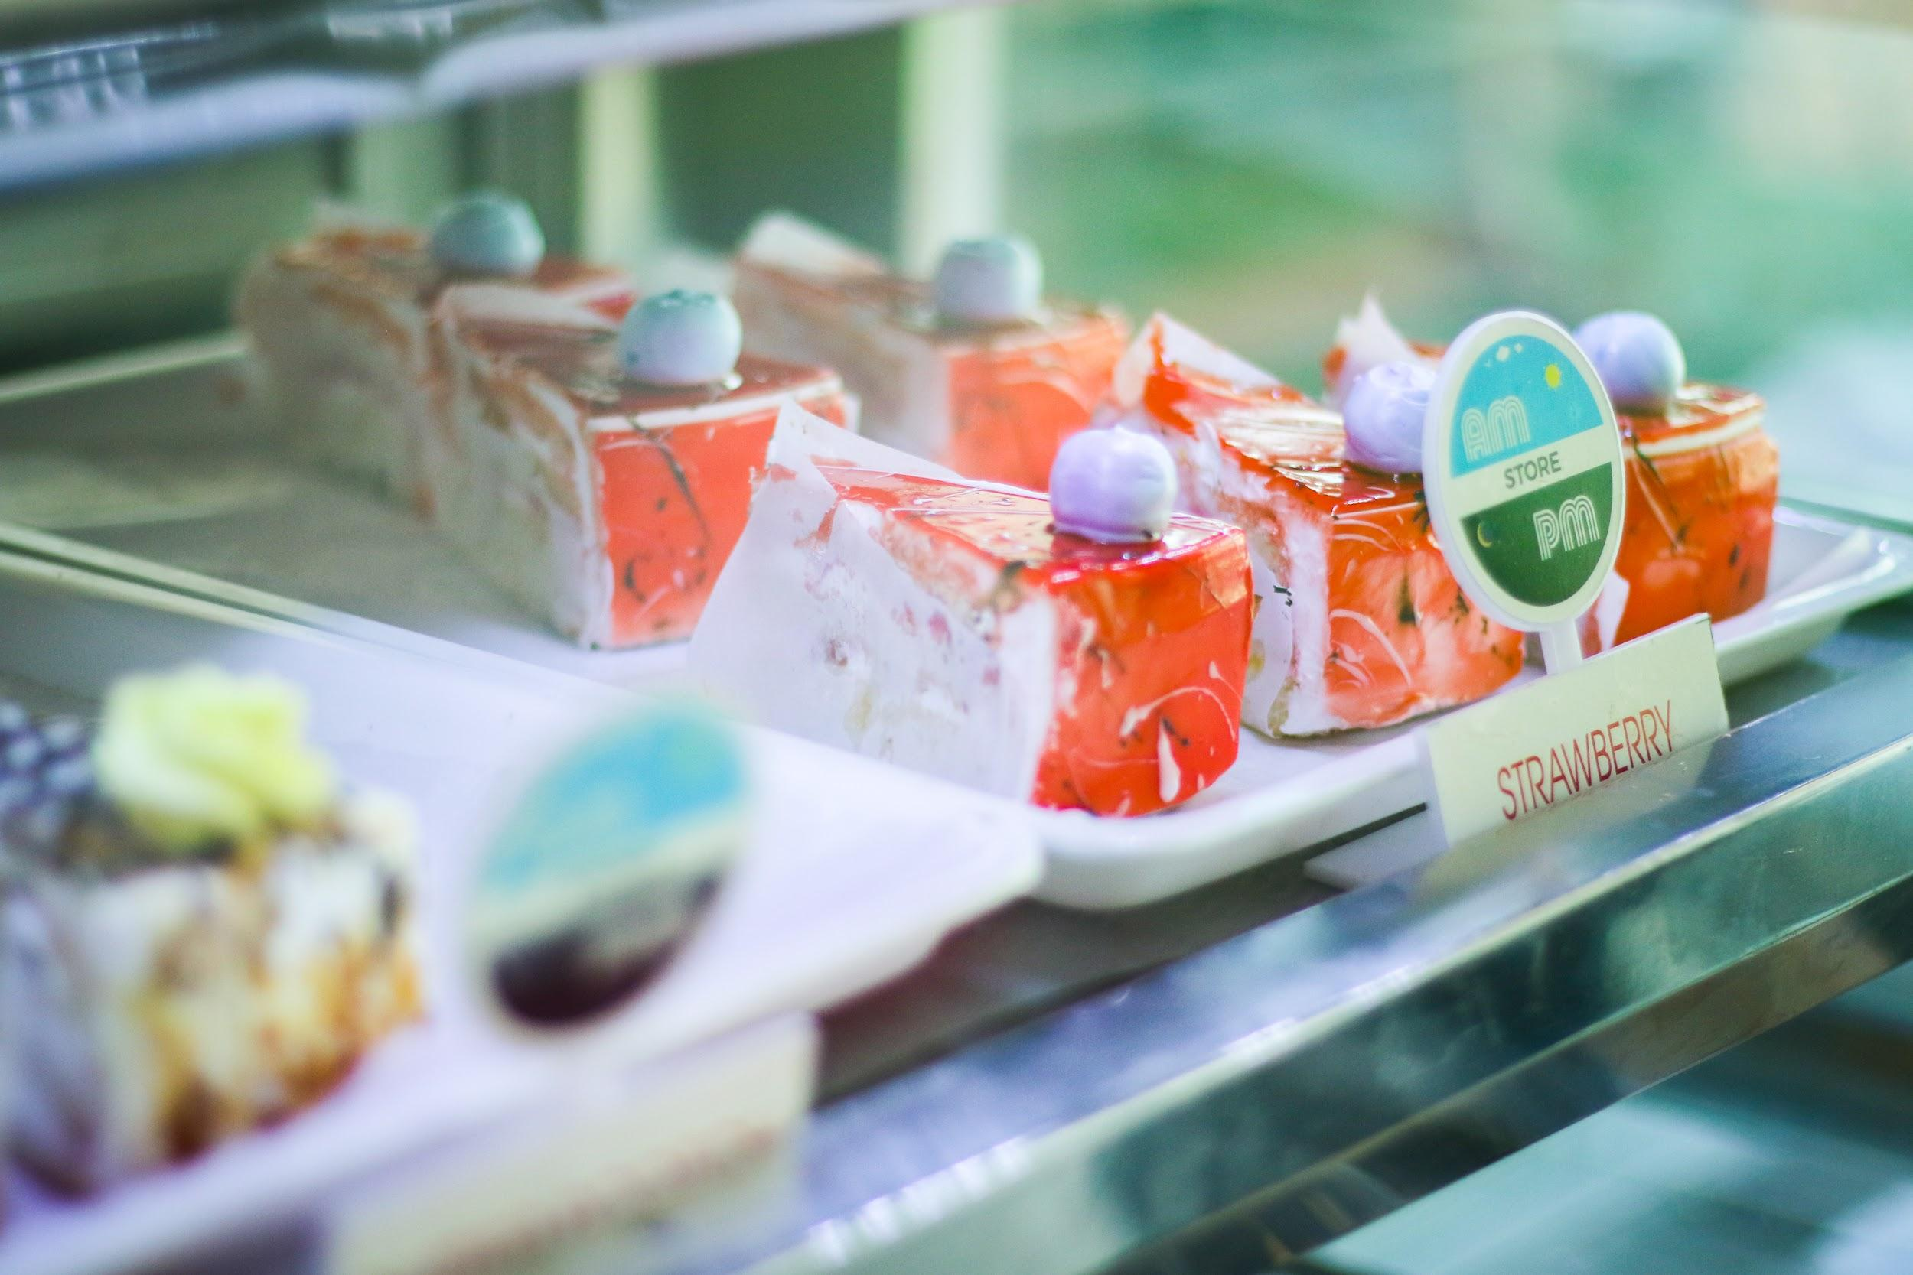
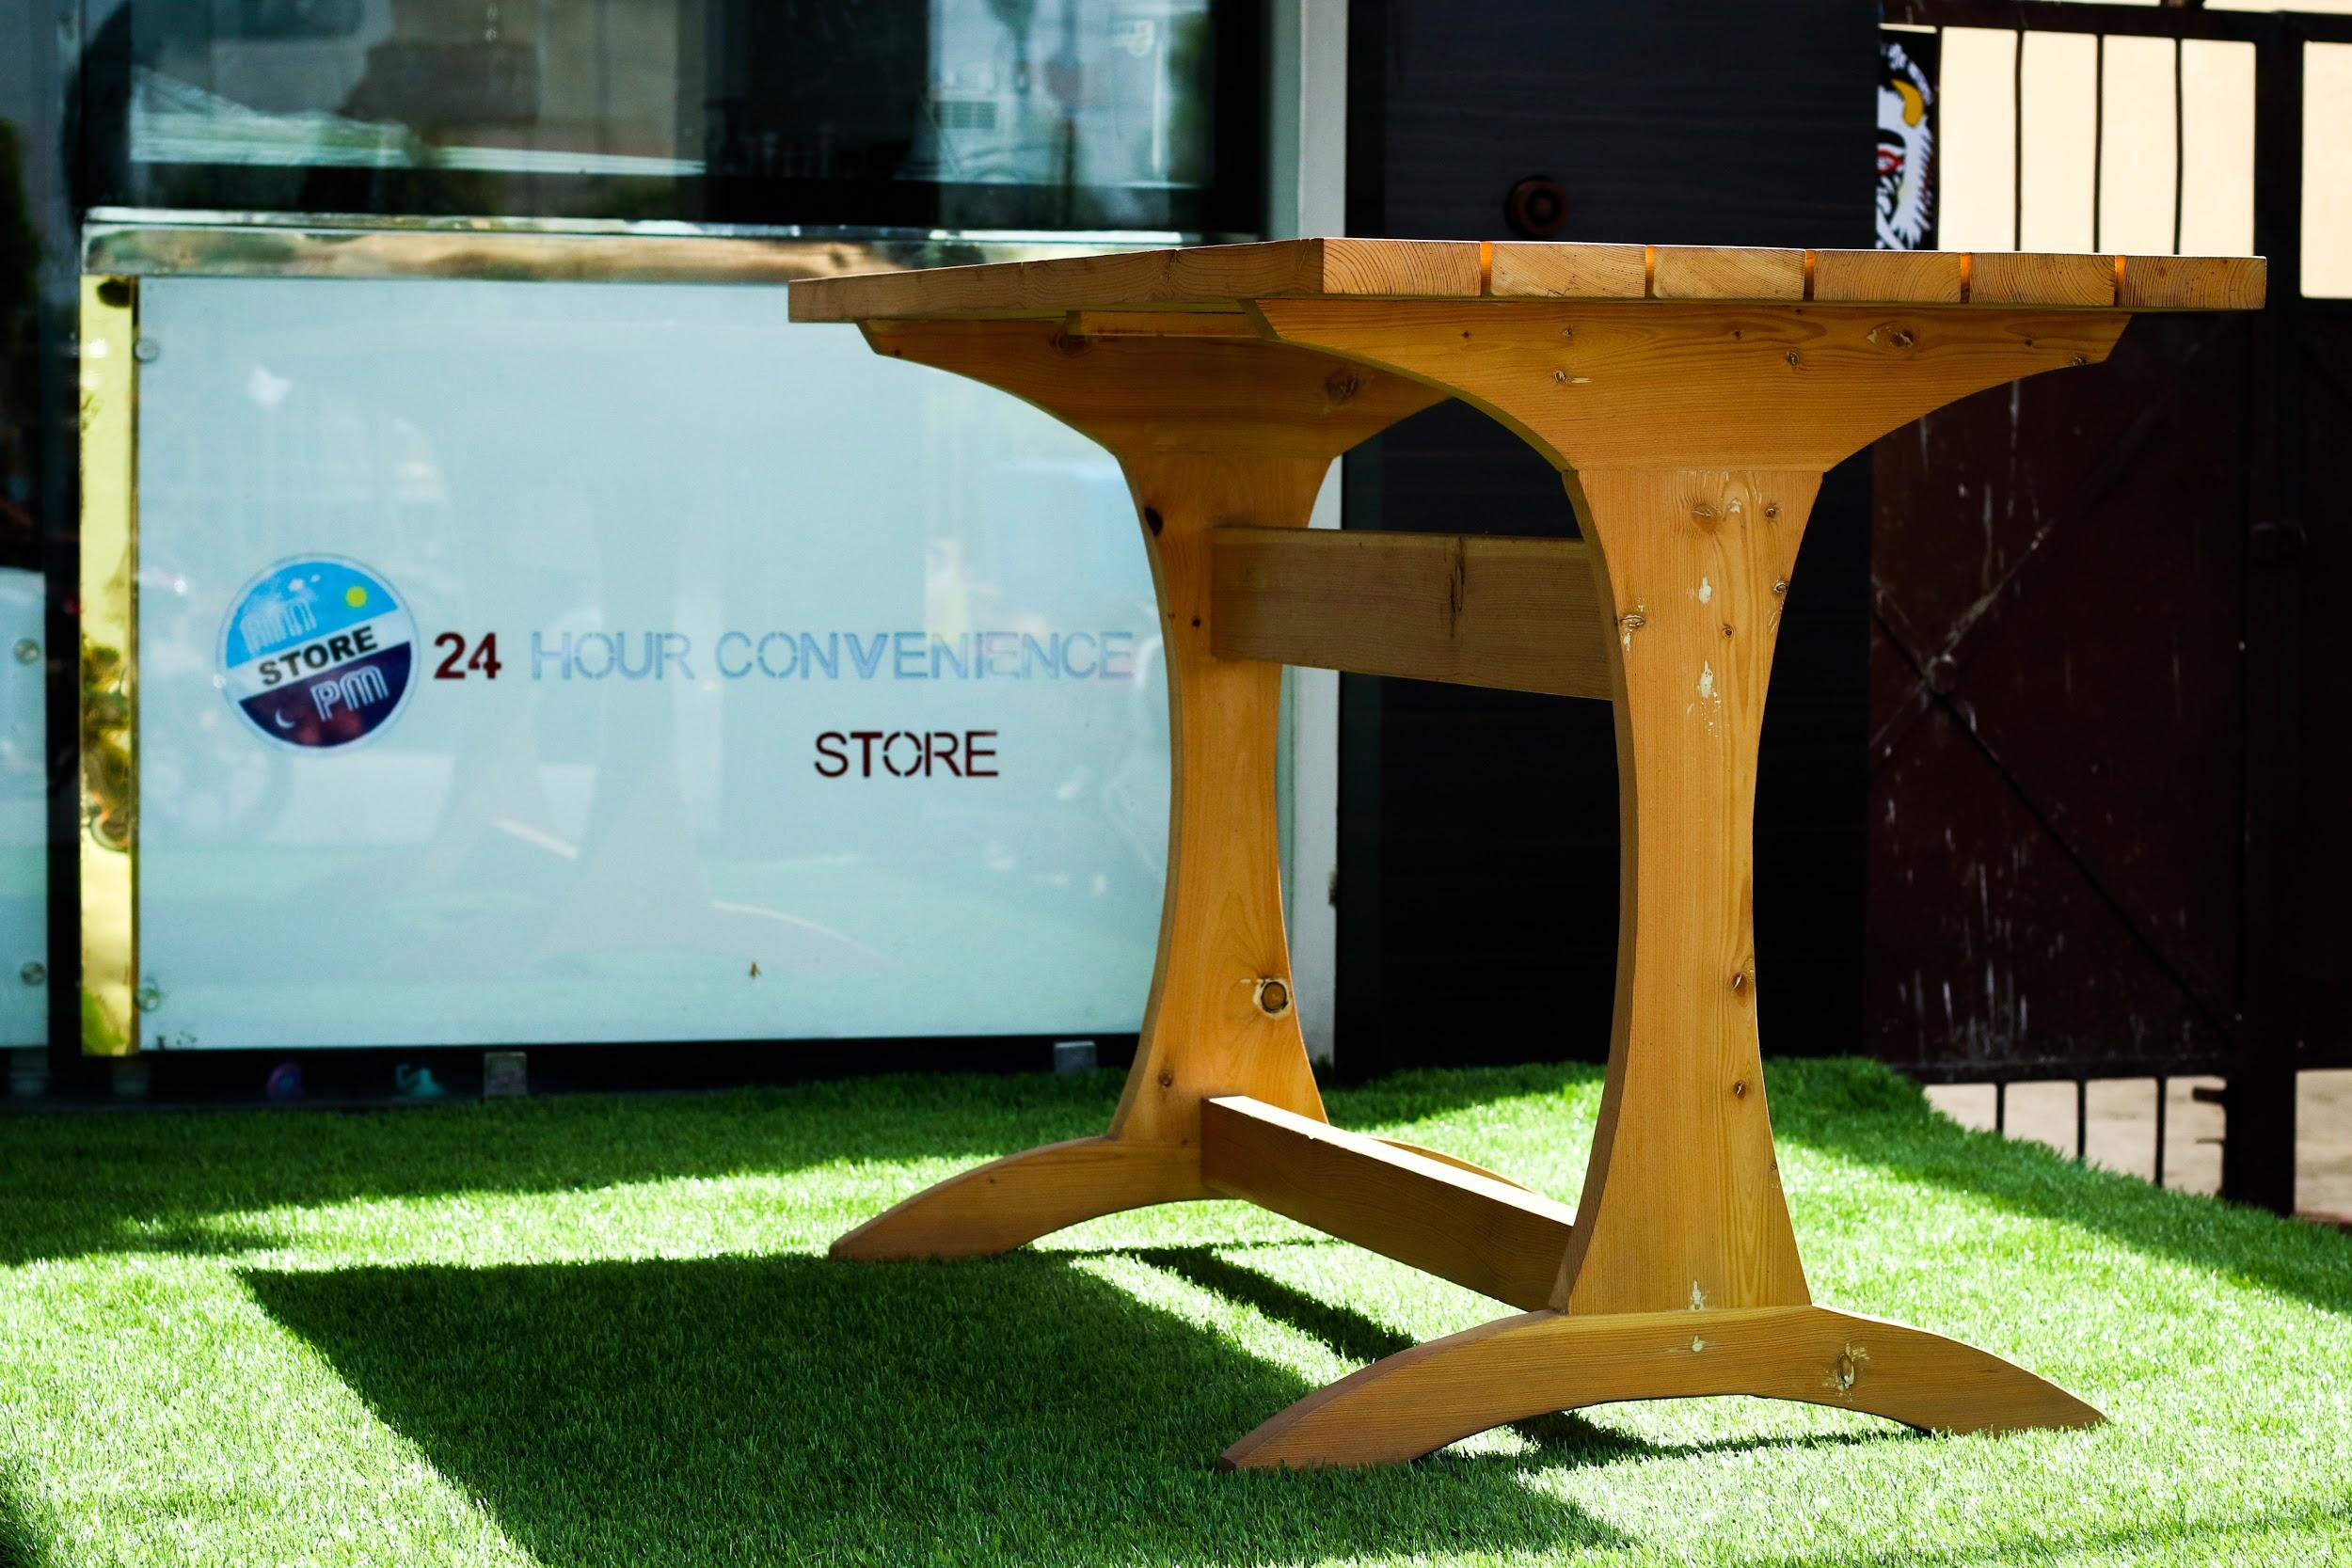
The AMPM Store

Slide 14




We’re Social
@AMPMSTOREINDIA
@AMPMSTOREINDIA
www.ampmstore.in
AMPM Store

Slide 15

THANK YOU!

